Slide 1
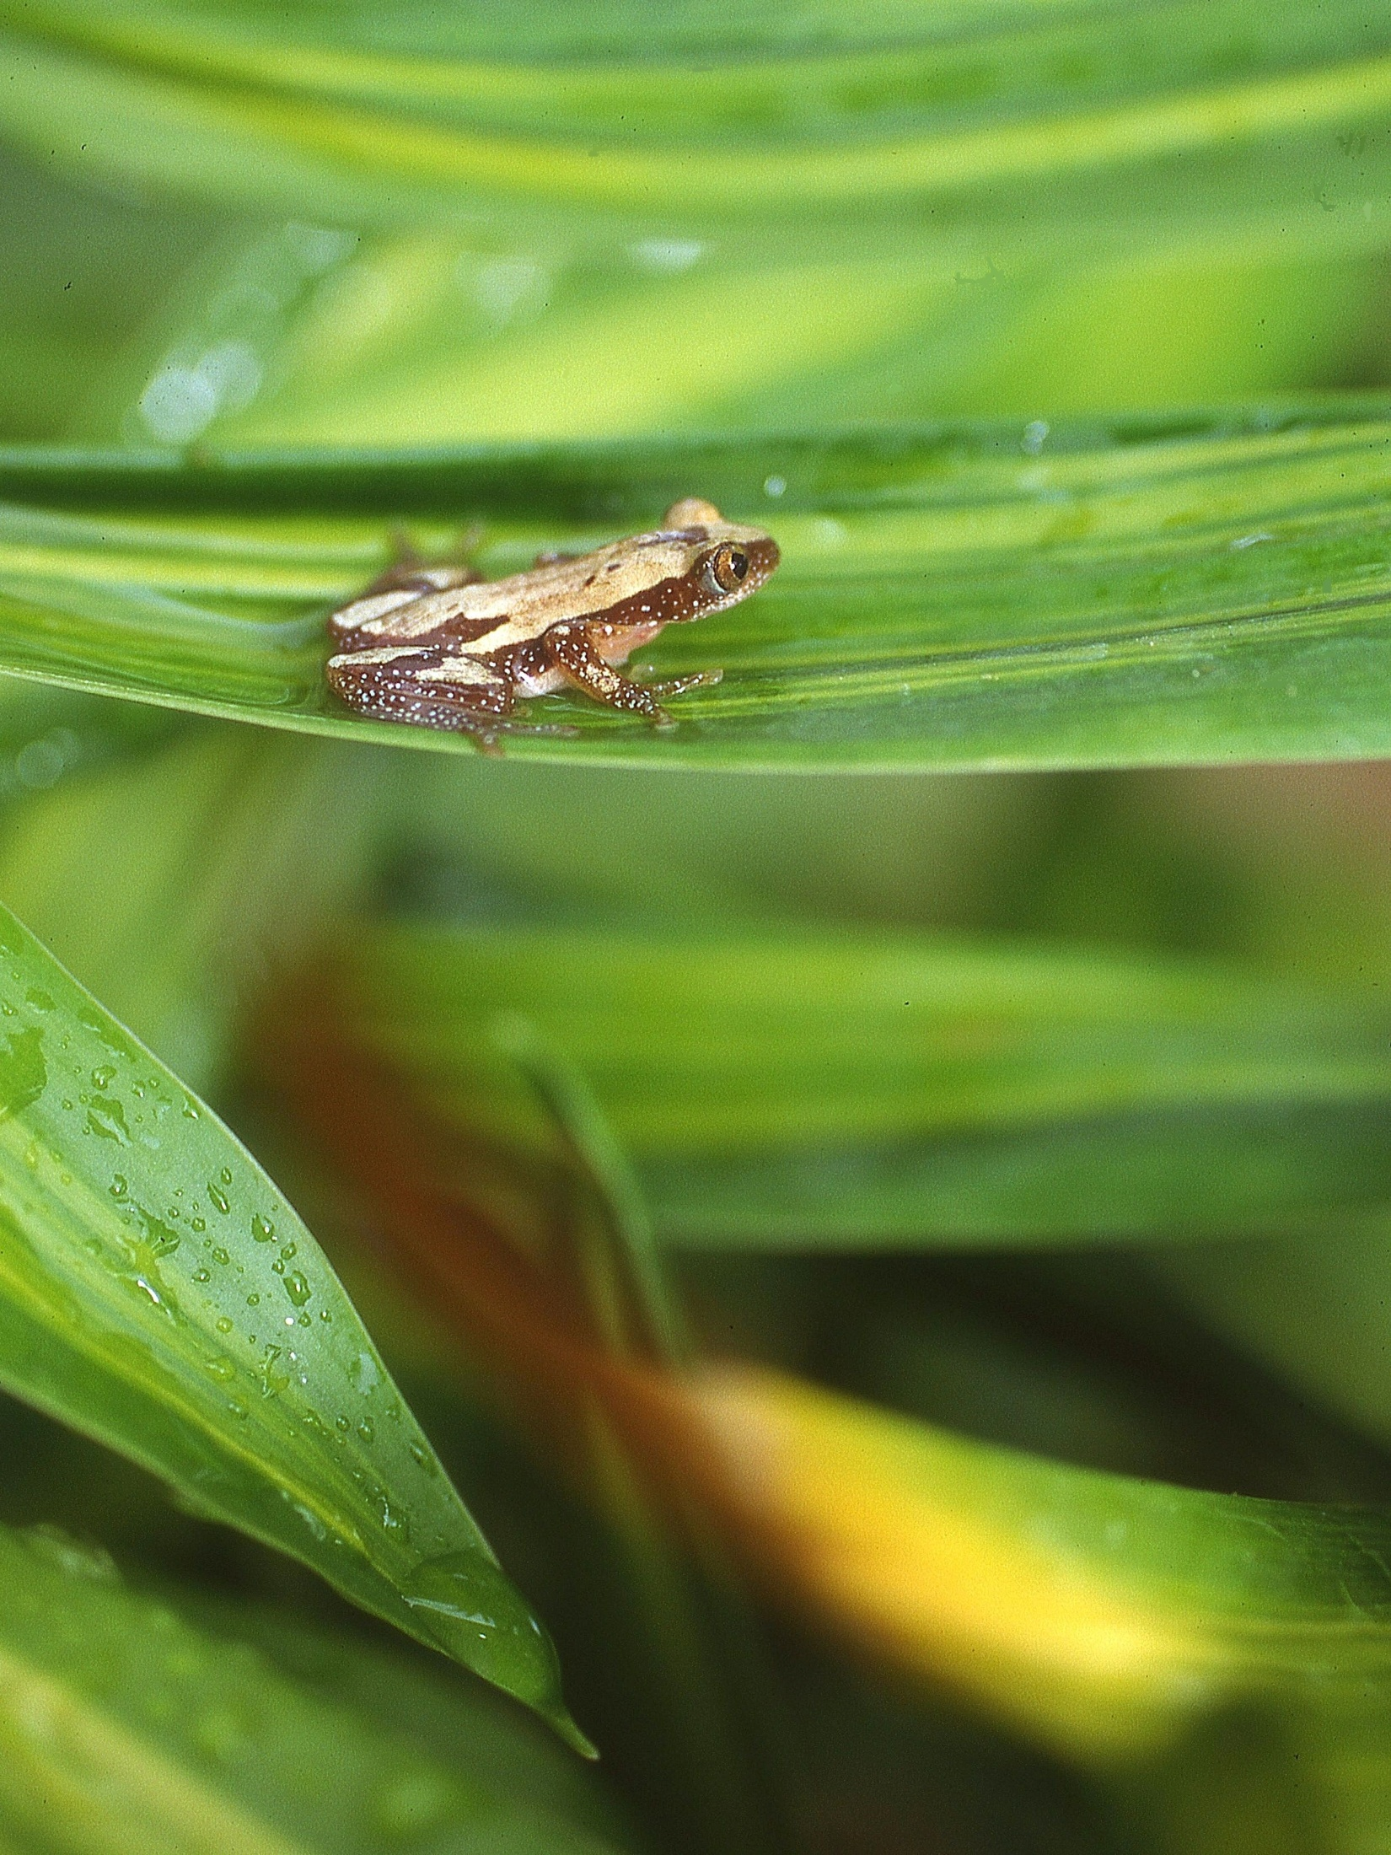
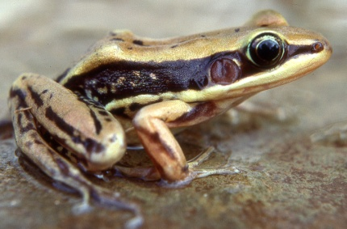
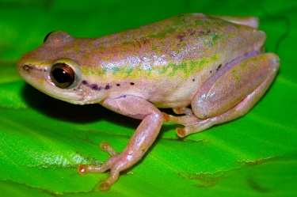
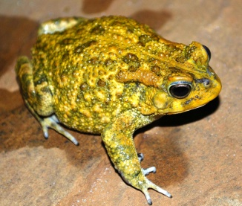
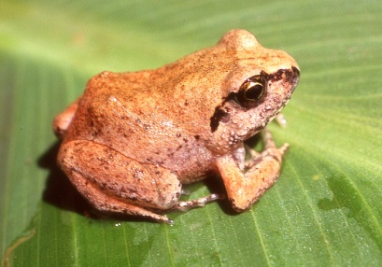
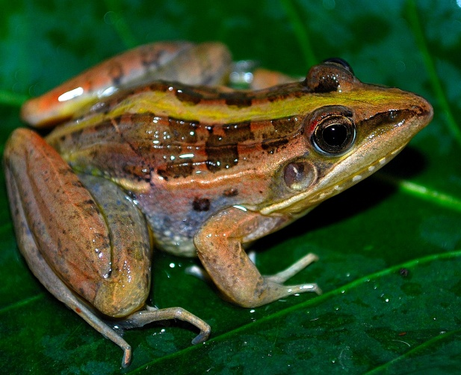
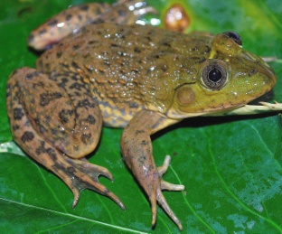
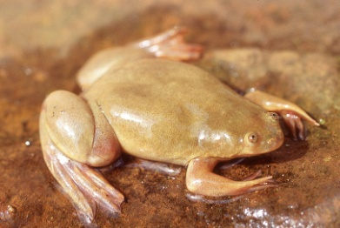
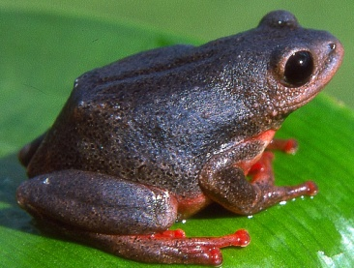
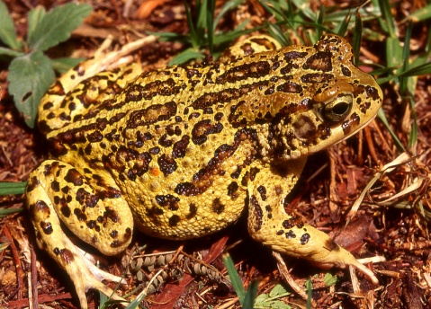
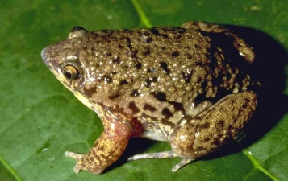
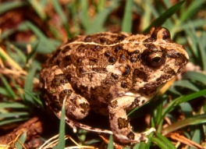
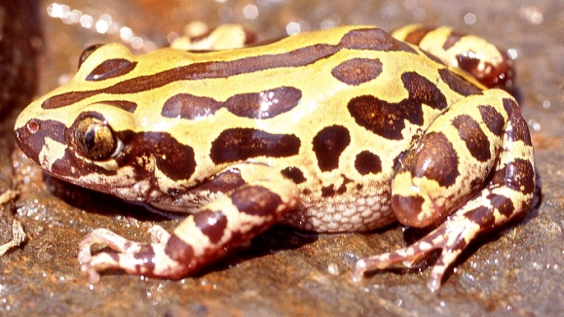
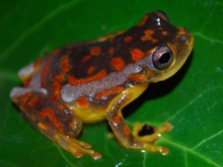
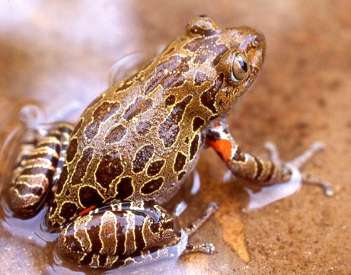
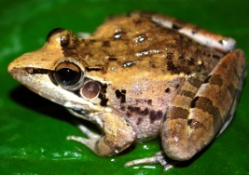
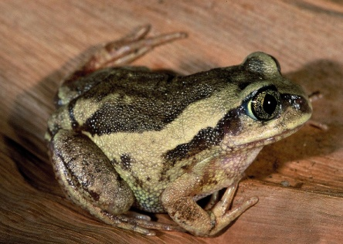
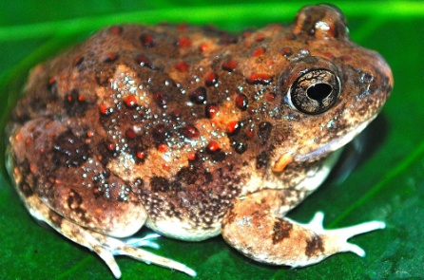
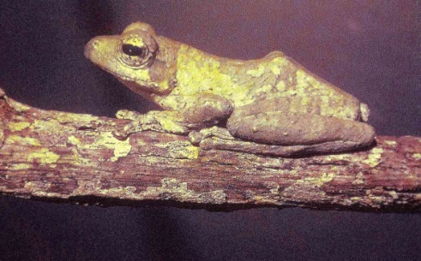
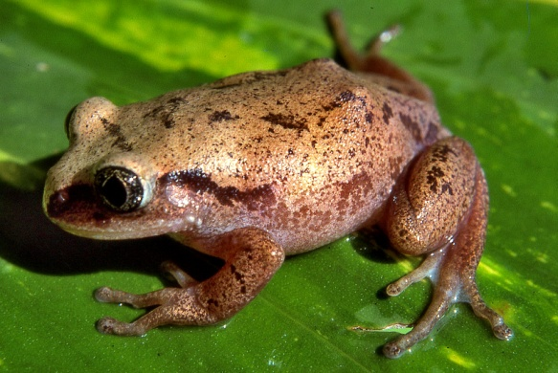
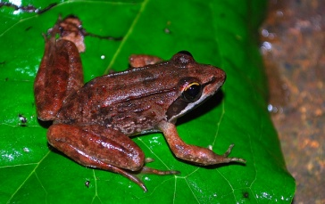
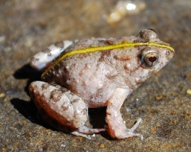
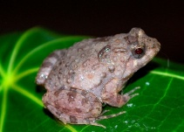
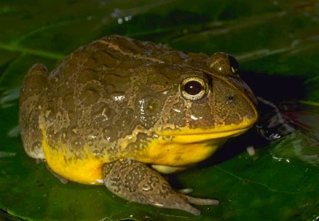
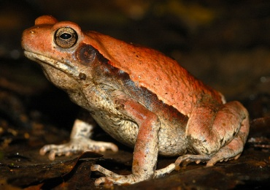
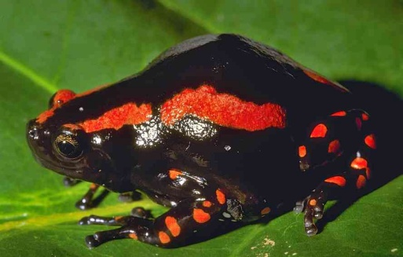
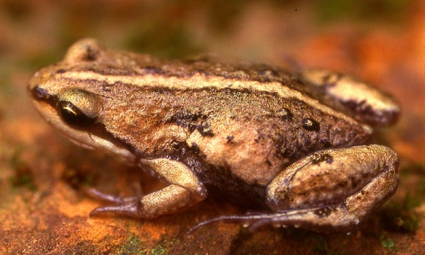
Know your frogs!
About 100 species of frog are known from Kenya.
Mascarene rocket frog Ptychadena mascareniensis
Kivu reed frog Hyperolius kivuensis
Galam white-lipped frog Hylarana galamensis
Guttural Toad, Sclerophrys gutturalis
Common Squeaker, Arthroleptis stenodactylus
Dwarf leaf-folding frog Afrixalus brachycnemis
Common reed frog Hyperolius glandicolor
Eastern Groove crowned Bullfrog, Hoplobatrachus occipitalis
Lake Victoria clawed frog Xenopus victorianus
Shimba Hills Reed Frog Hyperolius rubrovermiculatus
Marbled snout-burrower Hemisus marmoratus © Bob Drewes
Cryptic Sand Frog Tomopterna cryptotis
Senegal kassina Kassina senegalensis
Red-legged kassina Kassina maculata
Garman’s toad Sclerophrys garmani
Bocage’s burrowing tree frog Leptopelis bocagii © Michele Menegon
Red Sand Frog, Tomopterna luganga
Kreft’s Warty Frog, Callulina kreffti
Anchieta’s Rocket Frog, Ptychadena anchietae
Natal puddle frog Phrynobatrachus natalensis
Glade tree frog Leptopelis argenteus
Nutt’s River Frog, Amietia nutti
Southern foam-nest tree frog Chiromantis xerampelina (picture Alex MacKay)
Edible bullfrog Pyxicephalus edulis
© Bob Drewes
Kinangop dainty frog Cacosternum kinangopensis
Red -backedToad, Schismaderma carens
Red-banded rubber frog Phrynomantis bifasciatus © Bob Drewes
Copies of this poster can be obtained from stevespawls@hotmail.com or downloaded free, from www.kenyareptileatlas.com
Get background information at amphibiaweb.com or the African amphibians scratchpad
Frogs can be identified by and donated to the Herpetology Section, National Museum, Nairobi.

