Slide 1
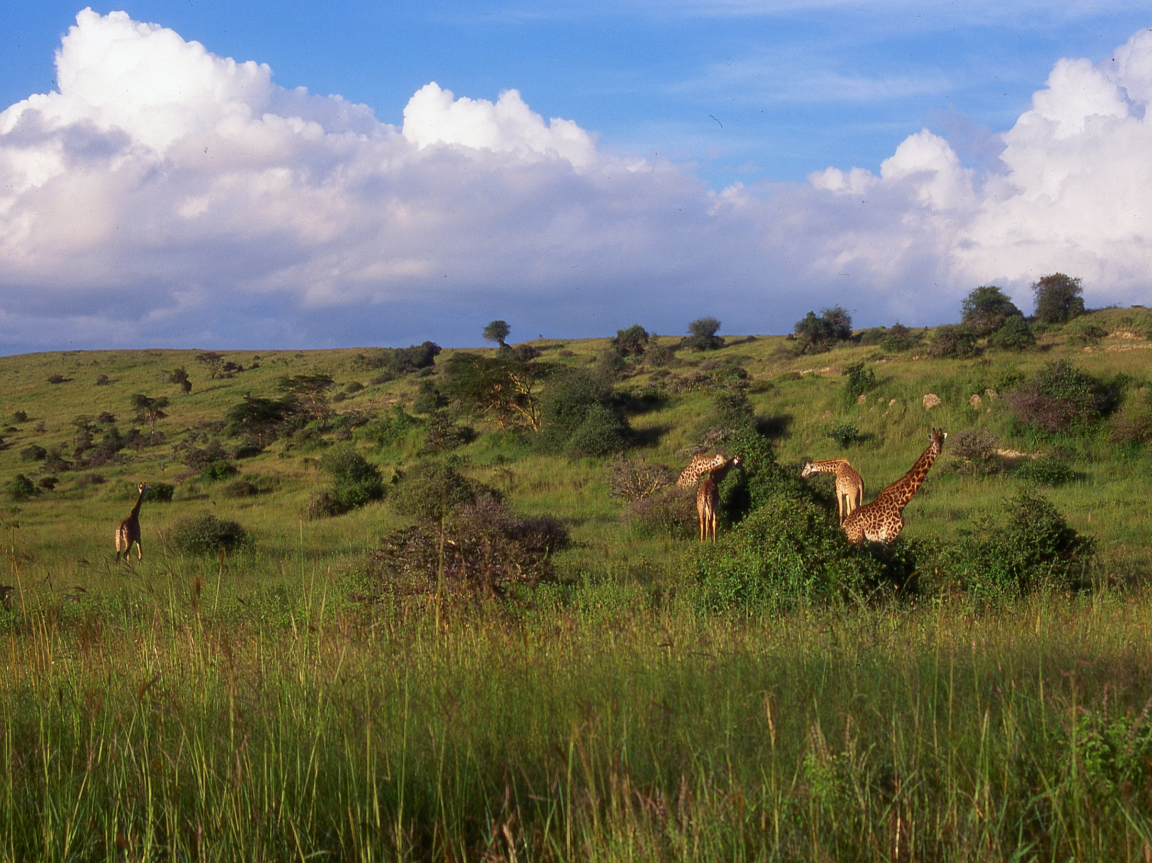
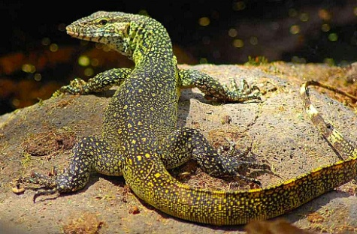
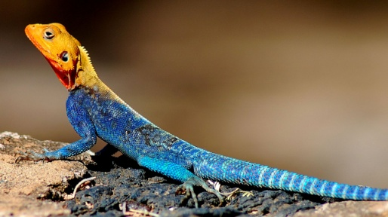
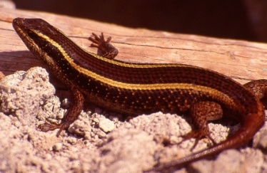
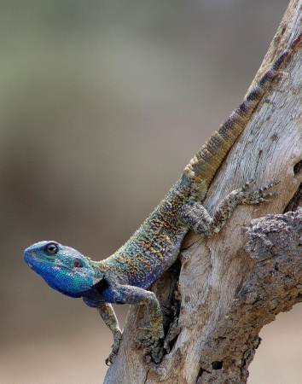
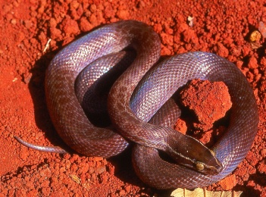
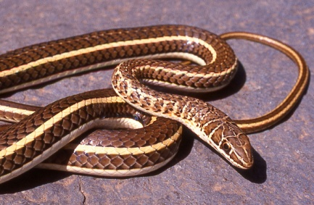
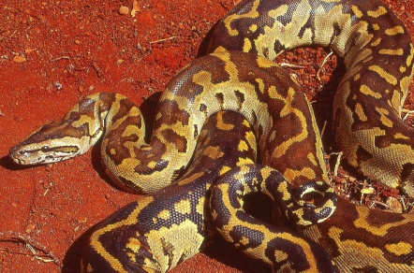
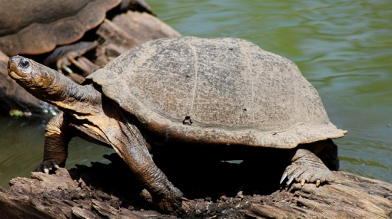
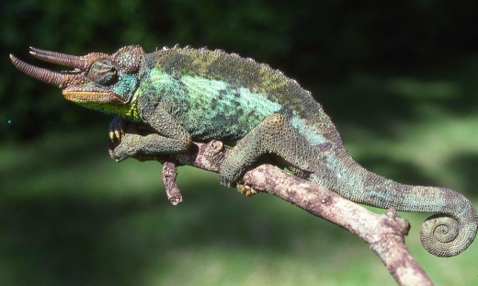
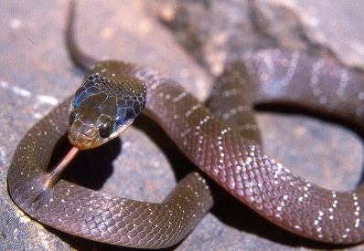
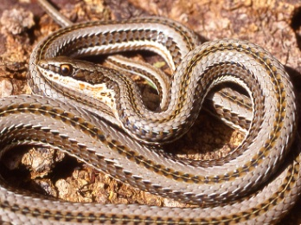
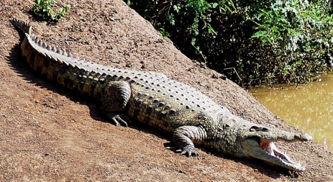
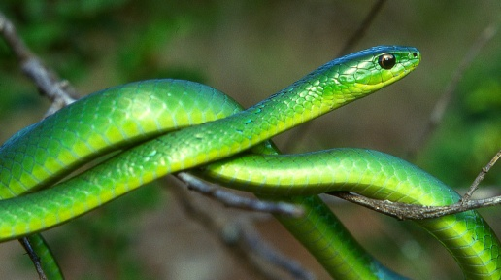
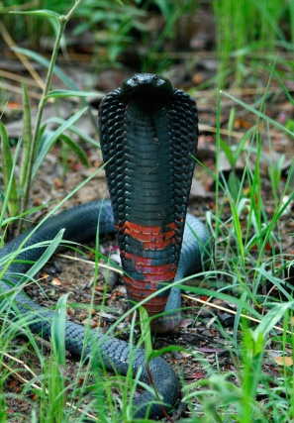
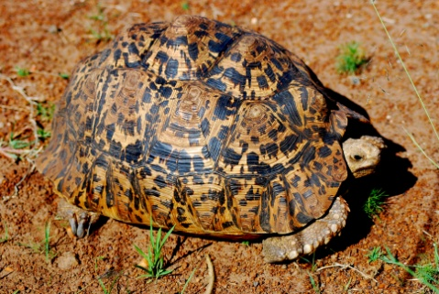
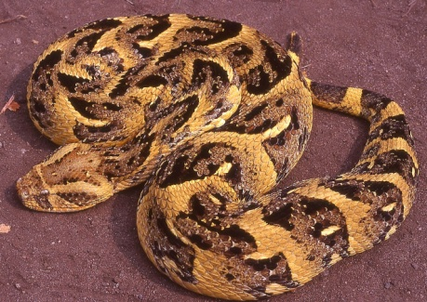
Some Common Reptiles of Nairobi National Park
Nile monitor, Varanus niloticus
Red-headed rock agama, Agama lionotus
Striped skink, Trachylepis striata
Blue-headed tree agama, Acanthocercus atricollis © Daniel Hollands
Brown house snake, Boaedon fuliginosus
Stripe-bellied sand snake, Psammophis sudanensis
Rock python, Python sebae
Serrated hinged terrapin, Pelusios sinuatus
Jackson’s chameleon, Trioceros jacksoni
White-lip, Crotaphopeltis hotamboeia
Kenyan striped skaapsteker, Psammophylax multisquamis
Nile crocodile, Crocodylus niloticus
Black-necked spitting cobra, Naja nigricollis HIGHLY VENOMOUS
Battersby’s green snake, Philothamnus battersbyi
Puff adder, Bitis arietans. HIGHLY VENOMOUS
Leopard tortoise, Stigmochelys pardalis
Electronic copies of this poster can be obtained from stevespawls@hotmail.com, or downloaded from www.kenyareptileatlas.com. Report interesting sightings to Kenya Wildlife Services or to the Herpetology Section, National Museum, Kenya.

